Slide 1


Santa Teresa High School PTO
October PTO Meeting
Fall into Saints spirit!
Wednesday, October 14, 2026
6:30 PM / School library + virtual
SANTA TERESA PTO OCTOBER 14, 2026
01
Notes:
Welcome families. Meeting October 14, 2026 at 6:30 PM in the school library and virtually. Sources: https://www.stpto.org/meetings and the live STHS calendar linked at https://santateresahigh.esuhsd.org/.

Slide 2
In loving memory of Robbie Hansen
Forever part of our Saints family
Our hearts are with Robbie’s family, friends,
classmates and all who loved him.
We send our deepest condolences and thank our
school and community for surrounding his family
with love and support.
SANTA TERESA PTO OCTOBER 14, 2026
02
Notes:
Invite a brief moment of reflection. Condolence wording and name supplied and confirmed by Angellina Duran in this conversation. Keep this slide free of Halloween decoration.

Slide 3
Tonight’s conversation
School updates and upcoming meetings
PTO programs and community support
Texas Hold’em fundraiser and merchandise
Volunteer needs, officer reports and questions
SANTA TERESA PTO OCTOBER 14, 2026
03
Notes:
Suggested meeting flow. Invite officer reports for minutes and finances. No balances, approvals or motions have been invented.

Slide 4
School reminders for families
October 30: AP exam priority deadline
October 30: Panorama family survey closes
UPP form: helps secure school funding
Juniors: free SAT on March 3, 2027
SAT registration deadline: January 11, 2027
SANTA TERESA PTO OCTOBER 14, 2026
04
Notes:
Source: https://santateresahigh.esuhsd.org/principals-messages, October 5 and September 21 updates. AP standard fee $90, reduced fee $5 for approved students. Panorama closes Oct 30. Free junior SAT March 3, 2027, registration Jan 11, 2027. Source: https://santateresahigh.esuhsd.org/ for UPP form.

Slide 5
October community meetings
OCT 13
STMAA Band Boosters
7:00 PM, Band Room
OCT 14
PTO Meeting
6:30 PM, Library + virtual
OCT 19
School Site Council
3:45 PM, Library
OCT 21
Latino Parent Coalition
6:00 PM, Library
OCT 22
ESUHSD Board Meeting
4:00 PM, District
SANTA TERESA PTO OCTOBER 14, 2026
05
Notes:
Sources: live STHS calendar, https://calendar.google.com/calendar/ical/c_04vsq0dpmpkg8tf8802u9q0t9s%40group.calendar.google.com/public/basic.ics, checked October 10, 2026. https://www.stpto.org/meetings confirms Oct 14. The principal message contains an Oct 7 PTO date conflict; the live calendar and PTO schedule agree on Oct 14. November 11 appears in the posted PTO schedule; confirm any holiday change before announcing.

Slide 6
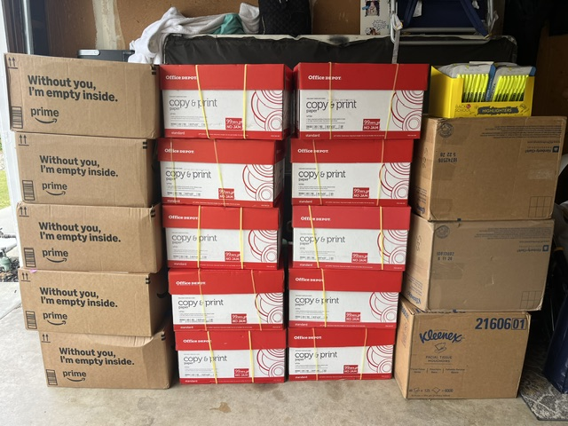
Tools for Teachers
Everyday supplies for our classrooms
Paper, notebooks, pens and pencils
Tissues and cleaning wipes
Snacks for students
Resource stations:
Attendance Office and Teacher’s Lounge
SANTA TERESA PTO OCTOBER 14, 2026
06
Notes:
Source and image: https://www.stpto.org/tools-for-teachers, September 2026. Photo: https://static.wixstatic.com/media/d75592_95a80e67e70143dc81057d6504ec0dc9~mv2.jpeg. Ask what supplies teachers need next.

Slide 7
Where our support goes
Teacher grants
Student scholarships
Classroom books and calculators
Science lab equipment
Art supplies and theater props
Audio and visual equipment
Support for graduating seniors
as they pursue education and
career opportunities after ST.
Awards depend on available funding.
SANTA TERESA PTO OCTOBER 14, 2026
07
Notes:
Sources: https://www.stpto.org/grants and https://www.stpto.org/scholarships. Scholarship award amounts depend on available funding. No current award amounts or application dates were posted in the reviewed pages.

Slide 8

Texas Hold’em fundraiser
Saturday, November 7
4:00 PM registration
5:00 PM game begins
$100 buy-in: dinner + two drinks
Adults 21+ / 100 participants
Rancho Santa Teresa Club
286 Sorrento Way, San Jose
SANTA TERESA PTO OCTOBER 14, 2026
08
Notes:
Source: event flyer supplied by Angellina Duran. Saturday November 7, 2026; registration 4 PM, game 5 PM; $100 buy-in; dinner and two drinks; 21+; 100 participants; Rancho Santa Teresa Club, 286 Sorrento Way, San Jose. Purchase URL https://stpto.square.site/. Square homepage was requested but catalog details were not readable.

Slide 9
Saints merchandise preorders
Cozy up in Saints style
Beanies $20
Hats $25
Gear $30–$75
All proceeds support our Saints community, including
teacher grants and student scholarships.
Unisex styles for cooler days
Preorder at STPTO.square.site
SANTA TERESA PTO OCTOBER 14, 2026
09
Notes:
Prices confirmed directly by Angellina Duran: beanies $20, hats $25, other gear $30–$75, unisex. All proceeds support the Saints community including teacher grants and student scholarships. Purchase link https://stpto.square.site/. Product catalog, sizes, stock and fulfillment dates could not be independently verified, so none are stated.

Slide 10
PTO reports and ways to help
Meeting minutes and treasurer’s report
Fundraiser volunteers, donations and sponsors
Teacher support and future event ideas
Questions, feedback and next steps
SANTA TERESA PTO OCTOBER 14, 2026
10
Notes:
Facilitator slide with discussion prompts, not claims about approved actions. Invite secretary and treasurer to present actual records. Source for general volunteer role: https://www.stpto.org/. Ask attendees about their availability and skills.

Slide 11
Stay connected
PTO news and programs
www.stpto.org
Merchandise, fundraiser registration and donations
STPTO.square.site
contact@stpto.org
Facebook: SantaTeresaPTO
Instagram: ST_PTO
Thank you for supporting our Saints community!
SANTA TERESA PTO OCTOBER 14, 2026
11
Notes:
Sources: https://www.stpto.org/, https://santateresahigh.esuhsd.org/. Social handles and email supplied in the approved newsletter. Ask families to share the newsletter and purchase link. Thank everyone for attending.

